Slide 1
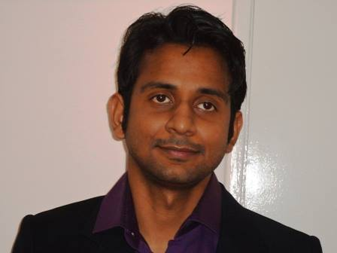
Document or presentation title
Speaker
Rahul Sahay
SDE, Kongsberg Digital
Sponsored by

Slide 2
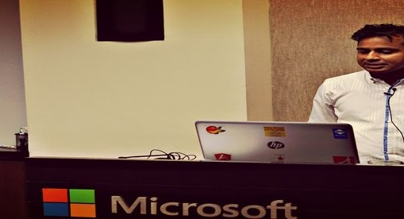







About Me
My View :- https://myview.rahulnivi.net
Microsoft MVP
Kongsberg Digital
@rahulsahay19
https://www.linkedin.com/in/rahulsahay19/
https://github.com/rahulsahay19
Microsoft Azure Architect Technologies Study Companion
Docker for .Net and Angular Developers

Slide 3
Getting Started with Microservices using Clean Architecture
Rahul Sahay

Slide 4

Layered Architecture Vs Domain Centric
Presentation
Presentation
Application
Business Logic
Domain
Data Access
Persistence
Infrastructure

Slide 5
Hexagonal Architecture
wire feed
answering machine adapter
http feed
email adapter
Application
test adapter
Triggers
Notifications
mock telephone
GUI
database tier
Http Adapter
Admin
Database
app-to-app adapter
mock database
test adapter

Slide 6


Onion Architecture
User Interface
Application Services
D
Domain Services
Domain
Model
Application Core
Infrastructure
Tests

Slide 7
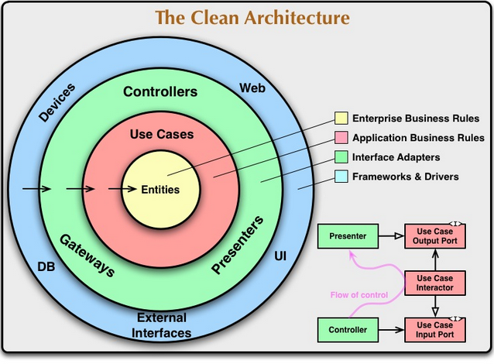
Source:- https://blog.cleancoder.com/uncle-bob/2012/08/13/the-clean-architecture.html

Slide 8
Domain driven models
Hexagonal
Onion
Clean
Domain

Slide 9
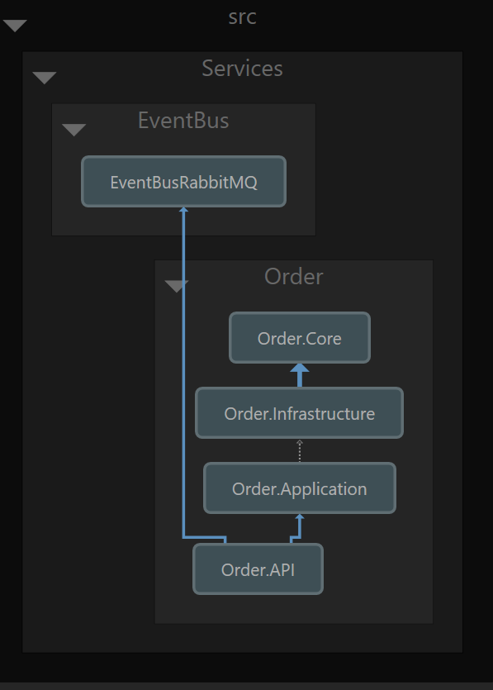
Project Dependencies of Ordering System

Slide 10
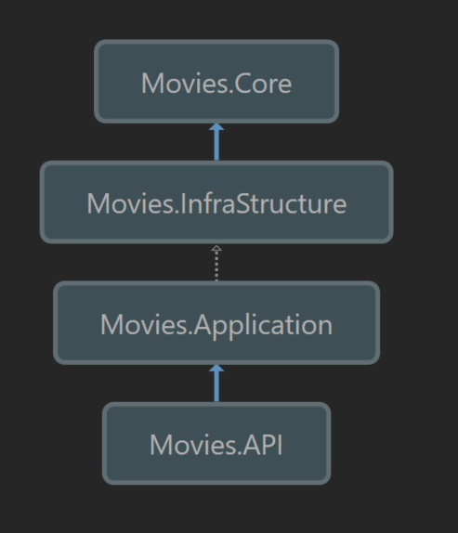
Project Dependencies of Movie System

Slide 11
Download Code
https://github.com/rahulsahay19/azconf-clean-architecture

Slide 12
Document or presentation title
Thank You!
Sponsored by

